Slide 1

Socket Programming
Md. Emdadul Haque
Professor
Department of ICE, RU
[Partially courtesy by Prof. Dr. Firoz Ahmed]

Slide 2
Outlines of Presentation
Introduction
Socket Basics
Socket-based Network Concepts
Client Server Basics
Client Server Algorithm
Socket for Client
Socket for Server

Slide 3
Socket Programming
This chapter presents key concepts of intercommunication between programs running on different computers in the network
It introduces elements of network programming and concepts involved in creating network applications using sockets
Java-based technologies offer many options for network communications, and one of the technologies is sockets
It introduces the java.net package containing various classes required for creating sockets and message communication using two different protocols
Here we learn how to use the Java classes Socket and ServerSocket from the package java.net

Slide 4
Introduction
To connect one computer with another computer the address of the computer is required
Internet Protocol (IP) uniquely identifies a computer on the internet
An IP address consists of 4 dotted decimal number 0 to 255
Example 130.225.0.1.
Remembering or handling so many number are is not easy
Meaningful names are used. Domain Name Server (DNS) is used to convert the name to the number
Example ru.ac.bd correspond to 103.79.117.77

Slide 5
Introduction
When a computer contacts ru.ac.bd, it first asks the DNS to translate this domain name into a numeric IP address and then sends the request using the IP address.
Internet Protocol (IP) is a low-level protocol for delivering data from one computer to another
Two higher-level protocols are used with IP
Transmission Control Protocol (TCP) uses Stream-based communications
User Datagram Protocol (UDP) uses packet-based communications.

Slide 6
Socket Programming
The Java API provides the classes for creating sockets to facilitate program communications over the Internet
Sockets are the endpoints of logical connections between two hosts and can be used to send and receive data
TCP/IP protocol maintains a socket connection for the whole period of communication

Slide 7
Socket Programming
The socket address is a pair:
IP address
Port
When a Java program creates an instance of the ServerSocket class, it just runs in memory and listens on the specified port for other program requests

Slide 8
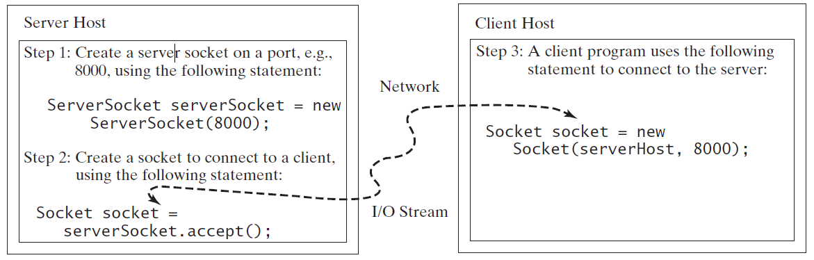
Socket Programming
To establish a server, you need to create a server socket and attach it to a port, which is where the server listens for connections.
Port numbers range from 0 to 65536, but port numbers 0 to 1024 are reserved for privileged services.
Fig: The server creates a server socket and, once a connection to a client is established, connects to the client with a client socket.

Slide 9
Socket Programming
Server Socket and Client Socket
The following lines create a server that is listening to port 4999:
The client program should create a client socket — an instance of the class Socket — pointing at the computer and port on which the ServerSocket is running
The client program can connect to the server using hostnames or IP addresses too, for example:
ServerSocket serverSocket = new ServerSocket(4999);
Socket s = serverSocket.accept();
clientSocket = new Socket(“124.67.98.101”, 3000);
clientSocket = new Socket(“localhost”, 3000);
clientSocket = new Socket(“liang.armstrong.edu”, 3000);

Slide 10
Socket Programming
Server Socket and Client Socket
When you create a socket with a host name, the JVM asks the DNS to translate the host name into the IP address.
Data Transmission through Sockets
After the server accepts the connection, communication between the server and the client is stated
The statements needed to create the streams and to exchange data between them are shown in the next Figure

Slide 11
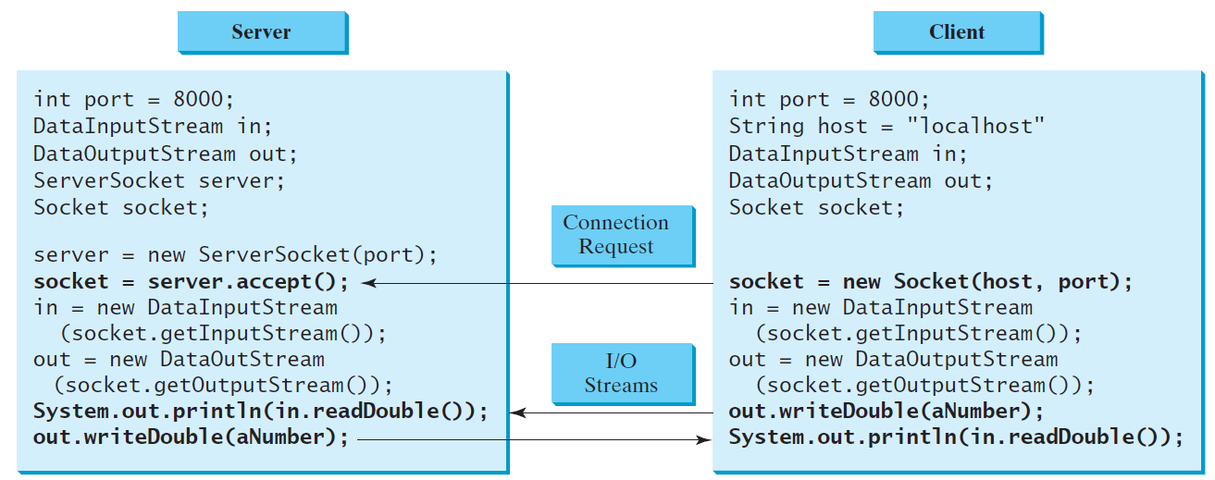
Socket Programming
Data Transmission through Sockets
FIGURE: The server and client exchange data through I/O streams on top of the socket.

Slide 12
Socket Programming
While deciding which port number to use for the ServerSocket, avoid using port numbers below to avoid conflicts with other system programs
For example,
port 80 is typically used by HTTP servers;
port 443 is reserved for HTTPS;
port 21 is typically used for FTP communications;
port 389 is for LDAP servers, and so on
After creating a socket-based connection, both client and server should obtain references to its input/output streams and use them for data exchange

Slide 13
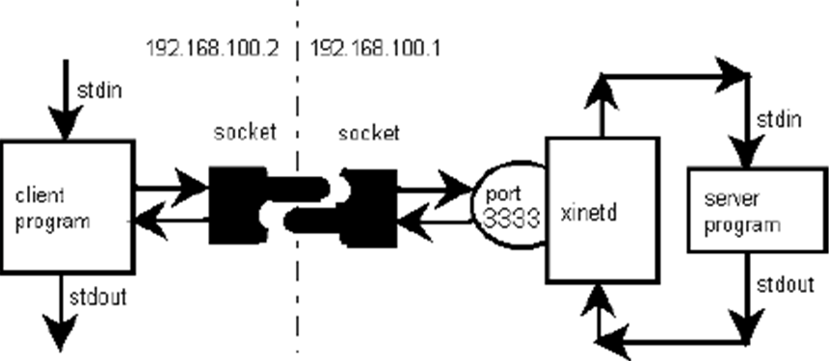
Socket
An interface between an application process and transport layer
The application process can send/receive messages to/from another application process (local or remote)via a socket

Slide 14
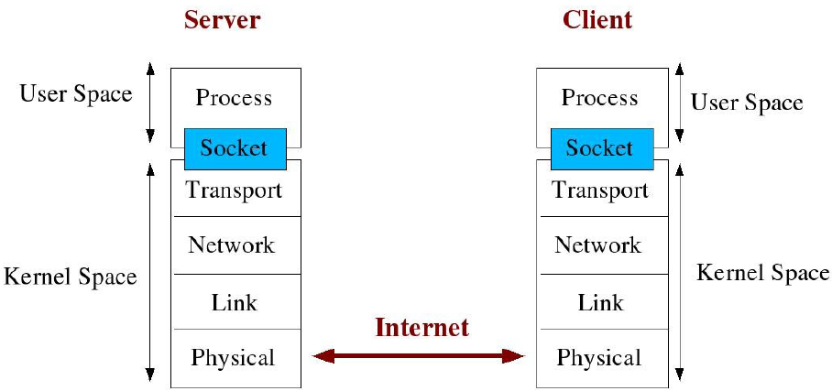
Socket Description

Slide 15
Types of Socket
Stream sockets
Interface to the TCP (transmission control protocol)
Datagram sockets
Interface to the UDP (user datagram protocol)
Raw sockets
Interface to the IP (Internet protocol)

Slide 16
Types of Socket
A socket programming construct can use either UDP or TCP transport protocols
Sockets that use UDP for transport of packets are called “datagram” sockets and
Sockets that use TCP for transport are called “stream” sockets

Slide 17
Types of Socket
Stream Sockets (SOCK_STREAM)
Connection oriented
Rely on TCP to provide reliable two-way connected communication
Datagram Sockets (SOCK_DGRAM)
Connection is unreliable
Rely on UDP

Slide 18
TCP vs. UDP
Transmission Control Protocol (TCP)
One-to-one
Connection-oriented
Reliable
In-order delivery
Transmission after Connect
User Datagram Protocol (UDP)
One-to-one or one-to many
Connectionless
Unreliable
Unordered delivery
Transmission with destination address

Slide 19
TCP vs. UDP
TCP used for services with a large data capacity, and a persistent connection
While UDP is more commonly used for quick lookups, and single use query-reply actions
Some common examples of TCP and UDP with their default ports:
DNS lookup UDP 53
FTP TCP 21
HTTP TCP 80
POP3 TCP 110
Telnet TCP 23

Slide 20
Java Sockets
Part of the java.net package
Import java.net.*;
Provides two classes of sockets for TCP
Socket – client side of socket
ServerSocket – server side of socket
Provides one socket type for UDP
DatagramSocket

Slide 21
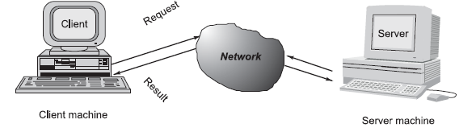
Client/Server Communication
Network-based systems consist of a server, client, and a media for communication
A computer running a program that makes a request for services is called client machine
A computer running a program that offers requested services from one or more clients is called server machine
The media for communication can be wired or wireless network

Slide 22
Client/Server Communication
Sockets are the most widely used programming interfaces for the transport layer protocols
TCP is a connection-oriented protocol that provides a reliable flow of data between two computers
Example applications that use such services are HTTP, FTP, and Telnet
UDP is a protocol that sends independent packets of data, called datagrams, from one computer to another with no guarantees about arrival and sequencing
Example applications that use such services include Clock server and Ping
The TCP and UDP protocols use ports to map incoming data to a particular process running on a computer

Slide 23
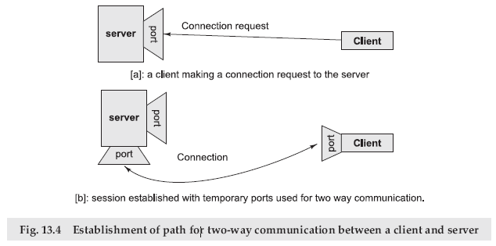
Sockets and Socket-based Communication
Sockets provide an interface for programming networks at the transport layer
Network communication using Sockets is very much similar to performing file I/O
In fact, socket handle is treated like file handle

Slide 24
SOCKET PROGRAMMING AND JAVA.NET CLASS
A socket is an endpoint of a two-way communication link between two programs running on the network
Java provides a set of classes, defined in a package called java.net
Key classes, interfaces, and exceptions in java.net package simplifying the complexity involved in creating client and server programs
The Classes | The Interfaces | Exceptions
URL | ContentHandlerFactory | BindException
URLConnection | FileNameMap | ConnectException
URLStreamHandler | SocketImplFactory | SocketException
URLEncoder | URLStreamHandlerFactor | ProtocolException

Slide 25
TCP/IP SOCKET PROGRAMMING
The two key classes from the java.net package used in creation of server and client programs are
ServerSocket
Socket
A server program creates a specific type of socket that is used to listen for client requests (server socket)
In the case of a connection request, the program creates a new socket through which it will exchange data with the client using input and output streams
The socket abstraction is very similar to the file concept
Developers have to open a socket, perform I/O, and close it

Slide 26
Steps for Creating a Simple Server Program
Open the Server Socket
ServerSocket server = new ServerSocket( PORT );
Wait for the Client Request
Socket client = server.accept();
Create I/O streams for communicating to the client
DataInputStream is = new DataInputStream(client.getInputStream());
DataOutputStream os = new DataOutputStream(client.getOutputStream());
Perform communication with client
Receive from client: String line = is.readLine();
Send to client: os.writeBytes(“Hello\n”);
Close socket
client.close();

Slide 27
Server Program
Example 1: A simple program where client sends a message to server and then server send a message to client
// Server program to send a message to Client receive a message from Client
import java.net.*;
import java.io.*;
public class server1 {
public static void main(String args[]) throws IOException {
// Create a server socket
ServerSocket ss = new ServerSocket(4999);
//Wait and accept a connection
Socket s1=ss.accept();
// Create data input stream
InputStream s1In = s1.getInputStream();
DataInputStream dis = new DataInputStream(s1In);
String st = new String (dis.readUTF());
System.out.println(st);
// Create data output stream
OutputStream s1out = s1.getOutputStream();
DataOutputStream dos = new DataOutputStream (s1out);
// Send a string!
dos.writeUTF("Hello Client1 from server First Message");
dos.close();
s1In.close();
s1out.close();
s1.close();
}
}

Slide 28
Client Program
Example 1: A simple program where client sends a message to server and then server send a message to client
// Client program to send a message to server and receive a message from server
import java.net.*;
import java.io.*;
public class client1 {
public static void main(String args[]) throws IOException {
// Create a socket to connect to the server
Socket s2 = new Socket("localhost",4999);
// Create data output stream
OutputStream s1out = s2.getOutputStream();
DataOutputStream dos = new DataOutputStream (s1out);
// Send a string
dos.writeUTF("Hello Server1, this from client Message #1 ");
// Create data input stream
InputStream s1In = s2.getInputStream();
DataInputStream dis = new DataInputStream(s1In);
String st = new String (dis.readUTF());
System.out.println(st);
dos.close();
s1In.close();
s1out.close();
s2.close();
}
}

Slide 29
Server and Client Program
// Example 1: Server program to send ...
import java.net.*;
import java.io.*;
public class server1 {
public static void main(String args[]) throws IOException {
// Create a server socket
ServerSocket ss = new ServerSocket(4999);
Socket s1=ss.accept(); //Wait and accept a connection
// Create data input stream
InputStream s1In = s1.getInputStream();
DataInputStream dis = new DataInputStream(s1In);
String st = new String (dis.readUTF());
System.out.println(st);
// Create data output stream
OutputStream s1out = s1.getOutputStream();
DataOutputStream dos = new DataOutputStream (s1out);
// Send a string!
dos.writeUTF("Hello Client1 from server First Message");
dos.close(); s1In.close(); s1out.close(); s1.close();
}
}
// Example 1: Client program to send a message
import java.net.*;
import java.io.*;
public class client1 {
public static void main(String args[]) throws IOException {
// Create a socket to connect to the server
Socket s2 = new Socket("localhost",4999);
// Create data output stream
OutputStream s1out = s2.getOutputStream();
DataOutputStream dos = new DataOutputStream (s1out);
// Send a string
dos.writeUTF("Hello Server1, this from client Message #1 ");
// Create data input stream
InputStream s1In = s2.getInputStream();
DataInputStream dis = new DataInputStream(s1In);
String st = new String (dis.readUTF());
System.out.println(st);
dos.close(); s1In.close(); s1out.close(); s2.close();
}
}

Slide 30
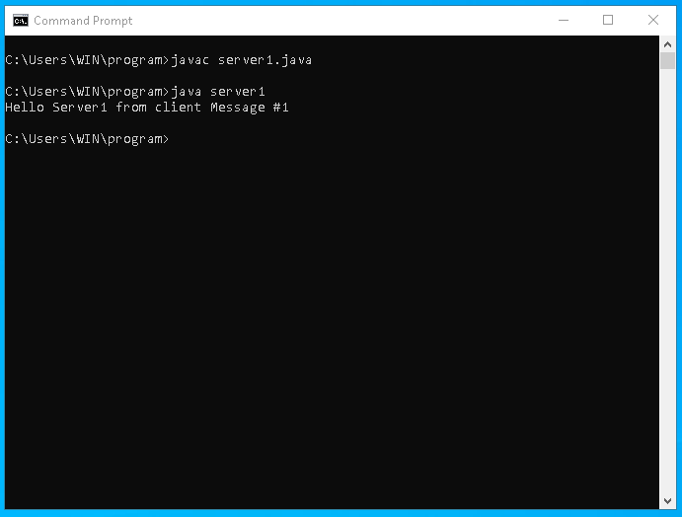
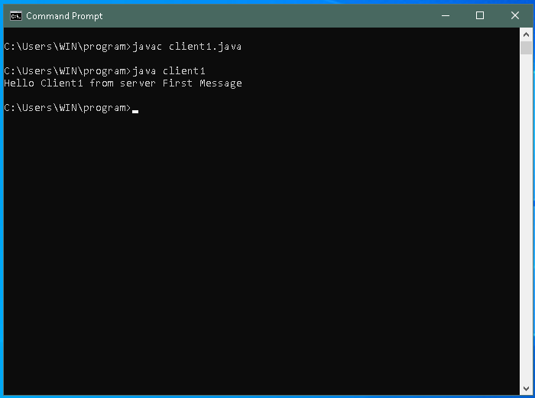
Program Output
Example 1: A simple program where client sends a message to server and then server send a message to client
Program Output:
//Server cmd window
// Client cmd window

Slide 31
Server Program
Example 2: A simple program where client sends two messages to server and then server send two messages to client
import java.net.*; // Server program
import java.io.*;
public class server2 {
public static void main(String args[]) throws IOException {
// Create a server socket
ServerSocket ss = new ServerSocket(4999);
//Wait and accept a connection
Socket s1=ss.accept();
//Receive First Message
InputStream s1In = s1.getInputStream();
DataInputStream dis = new DataInputStream(s1In);
String st = new String (dis.readUTF());
System.out.println(st); //First message output
OutputStream s1out = s1.getOutputStream();
DataOutputStream dos = new DataOutputStream (s1out);
// Send First Message
dos.writeUTF("Hello Client1 from server First Message");
//Receive Second Message
InputStream s1In2 = s1.getInputStream();
DataInputStream dis2 = new DataInputStream(s1In2);
String st2 = new String (dis2.readUTF());
System.out.println(st2); //Second message output
OutputStream s1out2 = s1.getOutputStream();
DataOutputStream dos2 = new DataOutputStream(s1out2);
// Send Second Message
dos2.writeUTF("Hello Client1 from server Second Message");
}
}

Slide 32
Client Program
Example 2: A simple program where client sends two messages to server and then server send two messages to client
import java.net.*; // Client program
import java.io.*;
public class client2 {
public static void main(String args[]) throws IOException {
//Create a server socket
Socket s1 = new Socket("localhost",4999);
// Send First Message
OutputStream s1out = s1.getOutputStream();
DataOutputStream dos = new DataOutputStream(s1out);
dos.writeUTF("Hello Server1 from client Message #1 ");
// Receive First Message
InputStream s1In = s1.getInputStream();
DataInputStream dis = new DataInputStream(s1In);
String st = new String (dis.readUTF());
System.out.println(st); //First Message output
//Second Second First Message
OutputStream s1out2 = s1.getOutputStream();
DataOutputStream dos2 = new DataOutputStream (s1out2);
dos.writeUTF("Hello Server1 from client Message #2 ");
// Receive Second Message
InputStream s1In2 = s1.getInputStream();
DataInputStream dis2 = new DataInputStream(s1In2);
String st2 = new String (dis2.readUTF());
System.out.println(st2); // Second Message output
}
}

Slide 33
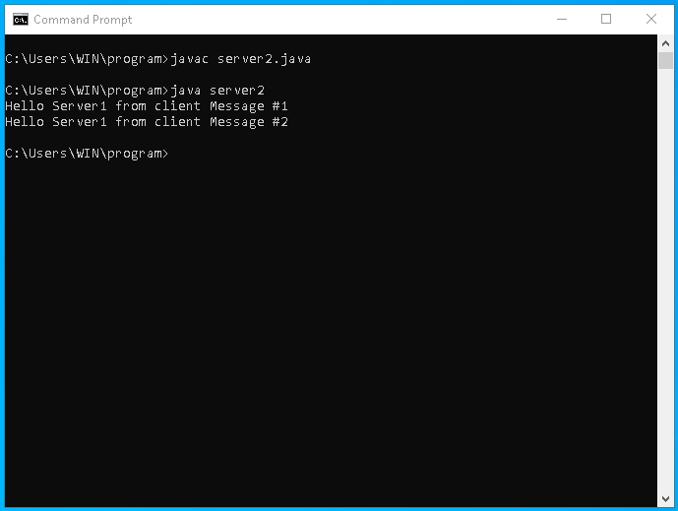
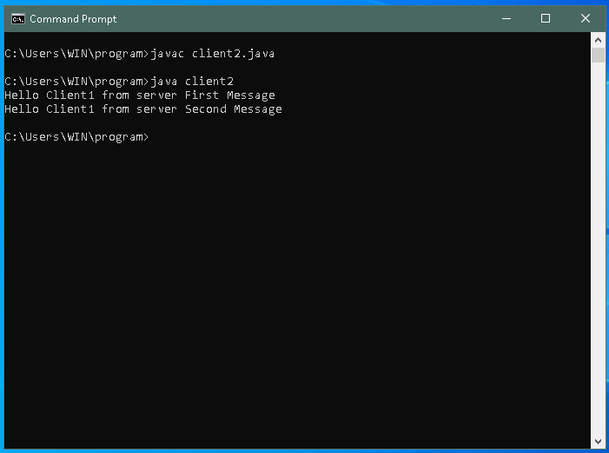
Program Output
Example 2: A simple program where client sends two messages to server and then server send two messages to client
Program Output:
//Server cmd window
// Client cmd window

Slide 34
Example 3: A program where a client sends radius of a circle to server, server then compute the area and send back to client
// Server Program
import java.net.*; import java.io.*;
public class serverArea {
public static void main(String args[]) throws IOException {
new Thread(() -> {
try {
// Create a server socket
ServerSocket ss = new ServerSocket(4999);
// Listen for a connection request
Socket s1=ss.accept();
// Create data input and output streams
DataInputStream s1In = new DataInputStream(s1.getInputStream());
DataOutputStream out = new DataOutputStream(s1.getOutputStream());
while (true) { //Infinity loop
// Receive radius from the client
double radius = s1In.readDouble();
System.out.println("Radius receive from client is " + radius);
// Compute area
double area = radius * radius * Math.PI;
System.out.println("Area send to client is " + area);
// Send area back to the client
out.writeDouble(area);
}
}
catch(IOException ex) {
ex.printStackTrace(); }
}).start();
}
}
// Client program
import java.net.*;
import java.io.*;
import java.util.Scanner;
public class clientArea {
public static void main(String args[]) throws IOException {
Socket cs = new Socket("localhost",4999);
//new Thread(() -> {
// try {
// Create data input and output streams
DataInputStream s1In = new DataInputStream(cs.getInputStream());
DataOutputStream out = new DataOutputStream(cs.getOutputStream());
while (true) {// Infinity loop
//Input from Keyboard
Scanner input = new Scanner(System.in);
System.out.print("Enter a number for radius: ");
double radius = input.nextDouble();
// Send radius to the server
out.writeDouble(radius);
// Receive area from server
double area= s1In.readDouble();
System.out.println("Area received from the server is " + area + " ");
}
// }
// catch(IOException ex) {
// ex.printStackTrace();
// }
//}).start();
}
}

Slide 35
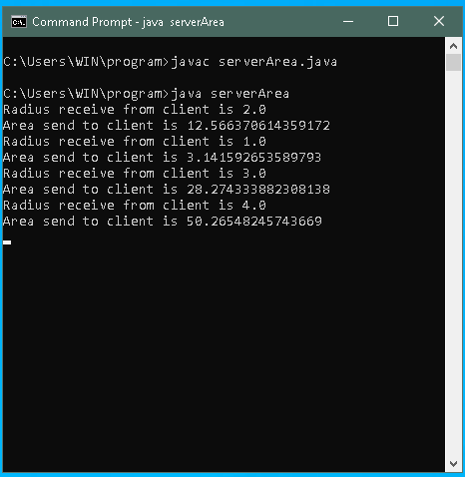
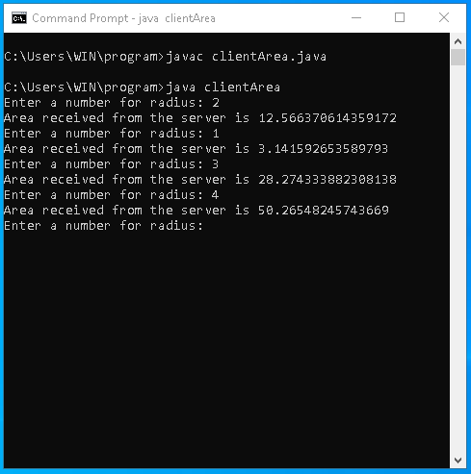
Program Output
Example 3: A simple program where client sends radius to server, server computes the area and then sends back the area to client
Program Output:
//Server cmd window
// Client cmd window

Slide 36
Example 4: A program where a server serves multiple client to compute the area of circles
// Server Program
import java.net.*; import java.io.*;
public class MultiThreadServer {
//Number a client
static int clientNo = 0;
public static void main(String args[]) throws IOException {
// Define the thread class for handling new connection
class HandleAClient implements Runnable {
private Socket socket; // A connected socket
/** Construct a thread */
public HandleAClient(Socket socket) {
this.socket = socket;
}
/** Run a thread */
public void run() {
try {
// Create data input and output streams
DataInputStream inputFromClient = new DataInputStream(socket.getInputStream());
DataOutputStream outputToClient = new DataOutputStream(socket.getOutputStream());
while (true) {// Continuously serve the client
// Receive radius from the client
double radius = inputFromClient.readDouble();
// Compute area
double area = radius * radius * Math.PI;
// Send area back to the client
outputToClient.writeDouble(area);
System.out.println("Radius received from client: " + radius + '\n');
System.out.println("Area send to client is: " + area + '\n');
}
}
catch(IOException ex) { ex.printStackTrace(); }
}
}
new Thread(() -> {
try {
// Create a server socket
ServerSocket ss = new ServerSocket(4999);
while (true) {
// Listen for a connection request
Socket skt = ss.accept();
clientNo++
// Create data input and output streams
DataInputStream s1In = new DataInputStream(skt.getInputStream());
DataOutputStream out = new DataOutputStream(skt.getOutputStream());
InetAddress inetAddress = skt.getInetAddress();
System.out.println("Client " + clientNo + "'s host name is " + inetAddress.getHostName() + "\n");
System.out.println("Client " + clientNo + "'s IP Address is " + inetAddress.getHostAddress() + "\n");
new Thread(new HandleAClient(skt)).start();
}
}
catch(IOException ex) { System.err.println(ex); }
}).start();
}
}

Slide 37
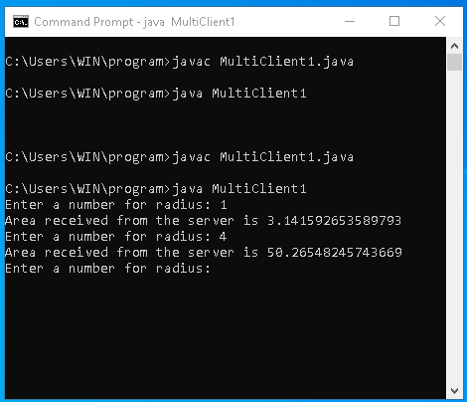
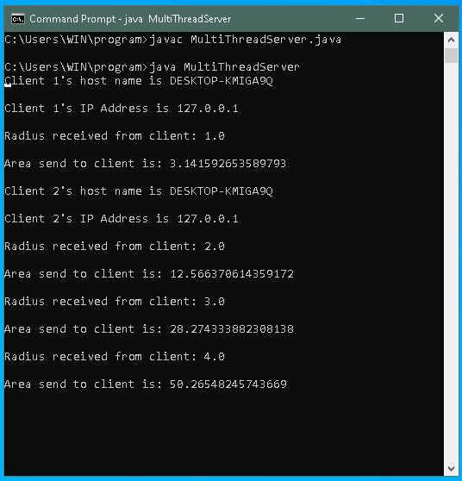
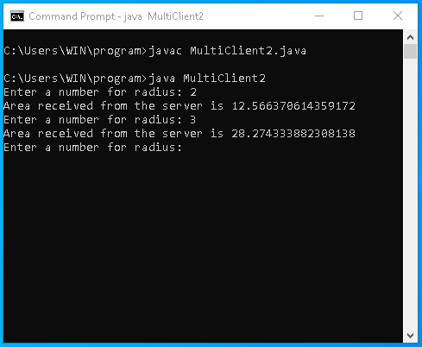
Example 3: Program output
// Client cmd windows
Program Output:
//Server cmd window

Slide 38
Datagram
TCP/IP-style networking is appropriate for most networking needs.
It provides a serialized, predictable, reliable stream of packet data.
TCP includes many complicated algorithms for dealing with congestion control on crowded networks, as well as pessimistic expectations about packet loss.
This leads to a somewhat inefficient way to transport data. Datagrams provide an alternative.
Datagrams are bundles of information passed between machines. Once the datagram has been released to its intended target, there is no assurance that it will arrive or even that someone will be there to catch it.

Slide 39
Datagram
Likewise, when the datagram is received, there is no assurance that it hasn’t been damaged in transit or that whoever sent it is still there to receive a response.
Java implements datagrams on top of the UDP protocol by using two classes: the DatagramPacket object is the data container, while the DatagramSocket is the mechanism used to send or receive the DatagramPackets.

Slide 40
Datagram
DatagramSocket
DatagramSocket defines four public constructors. They are shown here:
DatagramSocket( ) throws SocketException
DatagramSocket(int port) throws SocketException
DatagramSocket(int port, InetAddress ipAddress) throws SocketException
DatagramSocket(SocketAddress address) throws SocketException

Slide 41
Datagram
DatagramSocket
DatagramSocket defines many methods. Two of the most important are send( ) and receive( ), which are shown here:
void send(DatagramPacket packet) throws IOException
void receive(DatagramPacket packet) throws IOException

Slide 42
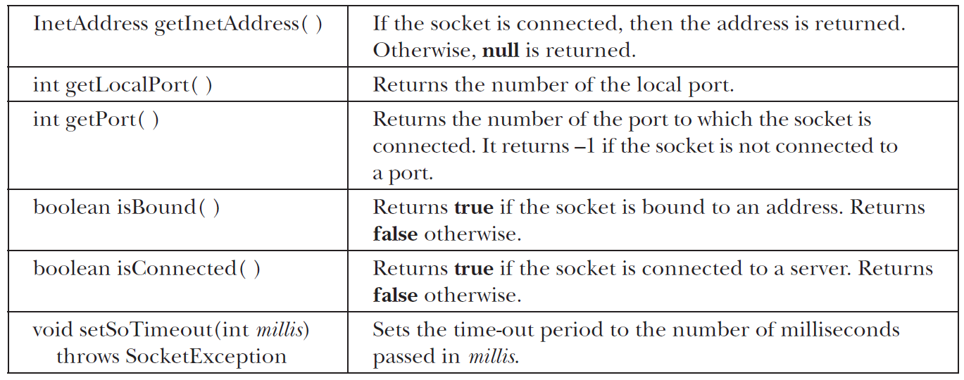
Datagram
DatagramSocket
Other methods give you access to various attributes associated with a DatagramSocket. Here is a sampling:

Slide 43
Datagram
DatagramPacket
DatagramPacket defines several constructors. Four are shown here:
DatagramPacket(byte data [ ], int size)
DatagramPacket(byte data [ ], int offset, int size)
DatagramPacket(byte data [ ], int size, InetAddress ipAddress, int port)
DatagramPacket(byte data [ ], int offset, int size, InetAddress ipAddress, int port)

Slide 44
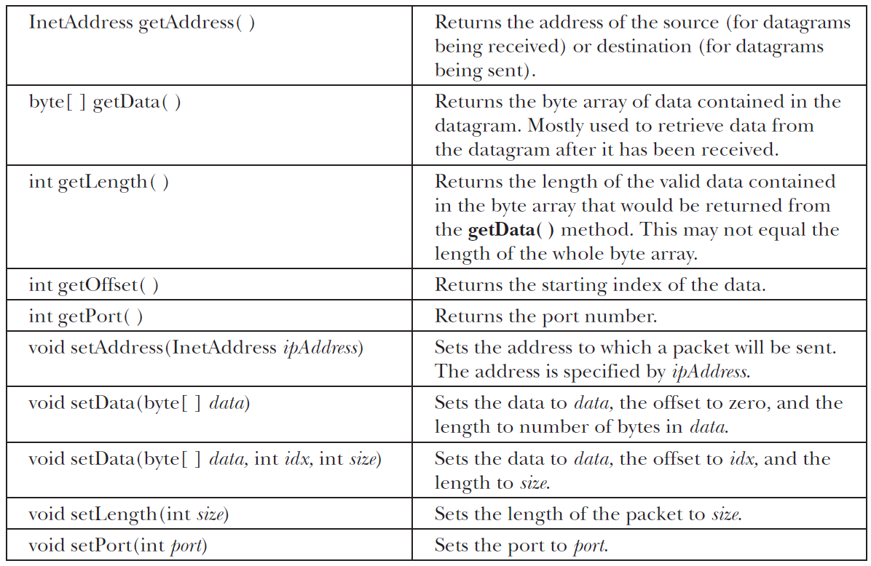
Datagram
DatagramPacket
DatagramPacket defines several methods, including those shown here, that give access to the address and port number of a packet, as well as the raw data and its length.

Slide 45
Server Program
Example: A server send a message packet to client
case -1:
System.out.println("The
execution of the server
has been terminated");
return;
case '\r':
break;
case '\n':
mySocket.send(new
DatagramPacket(myBuffer,
position,
InetAddress.getLocalHost(),
777));
position = 0;
break;
default:
myBuffer[position++] = (byte)charData;
} } }
// A server that sends messages to the client
import java.net.*;
class UDPServerEx {
public static DatagramSocket mySocket;
public static byte myBuffer[] = new byte[2000];
public static void serverMethod() throws Exception
{
int position = 0;
while (true) {
int charData = System.in.read();
switch (charData) {

Slide 46
Server Program
// A server that sends messages to the client
public static void main(String args[]) throws Exception
{
System.out.println("Please enter some text here");
mySocket = new DatagramSocket(888);
serverMethod();
}
}

Slide 47
Client Program
System.out.println(
new String(
dataPacket.getData(), 0,
dataPacket.getLength()));
}
}
public static void main(String args[]) throws Exception
{
System.out.println(
"You need to press CTRL+C"
+ " in order to quit.");
mySocket = new DatagramSocket(777);
clientMethod();
}
}
// UDPClient that receives messages
import java.net.*;
class UDPClient {
public static DatagramSocket mySocket;
public static byte myBuffer[] = new byte[2000];
public static void clientMethod() throws Exception
{
while (true) {
DatagramPacket dataPacket
= new DatagramPacket(myBuffer,
myBuffer.length);
mySocket.receive(dataPacket);
System.out.println("Message Received :");

